Slide 1
Topic 6: Arrays, Pointers and Stack Frames
José Nelson Amaral
University of Alberta

Slide 2
C Sort Example
Illustrates use of assembly instructions for a C bubble sort function
Swap procedure (leaf)
C code:
void swap(int v[], int k) { int temp; temp = v[k]; v[k] = v[k+1]; v[k+1] = temp; }
Assumption:
v ⟷ $a0
k ⟷ $a1
temp ⟷ $t0
P-H p. 149

Slide 3
C Sort Example
Assumption:
v ⟷ $a0
k ⟷ $a1
temp ⟷ $t0
Intermediate code (5):
tB ← k*4
tB ← v + tB
temp ← M[tB] tA ← M[tB+4]
M[tB] ← tA M[tB+4] ← temp
Intermediate code (5):
tB ← k*4
tB ← v + tB
temp ← M[tB] tA ← M[tB+4]
M[tB] ← tA M[tB+4] ← temp
Intermediate code (2):
temp ← M[v + k*4] tA ← M[v + (k+1)*4]
M[v + k*4] ← tA M[v +(k+1)*4] ← temp
C code:
void swap(int v[], int k) { int temp; temp = v[k]; v[k] = v[k+1]; v[k+1] = temp; }
Intermediate code (2):
temp ← M[v + k*4] tA ← M[v + (k+1)*4]
M[v + k*4] ← tA M[v +(k+1)*4] ← temp
Intermediate code (6):
tB ← $a1 << 2
tB ← $a0 + tB
$t0 ← M[tB] tA ← M[tB+4]
M[tB] ← tA M[tB+4] ← $t0
Intermediate code (6):
tB ← $a1 << 2
tB ← $a0 + tB
$t0 ← M[tB] tA ← M[tB+4]
M[tB] ← tA M[tB+4] ← $t0
Intermediate code (3):
tB ← v + k*4
temp ← M[tB] tA ← M[v + (k+1)*4]
M[tB] ← tA M[v +(k+1)*4] ← temp
Intermediate code (3):
tB ← v + k*4
temp ← M[tB] tA ← M[v + (k+1)*4]
M[tB] ← tA M[v +(k+1)*4] ← temp
Intermediate code (1):
temp ← M[v + k*4] M[v + k*4] ← M[v + (k+1)*4] M[v +(k+1)*4] ← temp
Intermediate code (1):
temp ← M[v + k*4] M[v + k*4] ← M[v + (k+1)*4] M[v +(k+1)*4] ← temp
Intermediate code (7):
$t1 ← $a1 << 2
$t1 ← $a0 + $t1
$t0 ← M[$t1] $t2 ← M[$t1+4]
M[$t1] ← $t2 M[$t1+4] ← $t0
Intermediate code (4):
tB ← v + k*4
temp ← M[tB] tA ← M[tB + 4]
M[tB] ← tA M[tB + 4] ← temp
Intermediate code (4):
tB ← v + k*4
temp ← M[tB] tA ← M[tB + 4]
M[tB] ← tA M[tB + 4] ← temp
P-H p. 149

Slide 4
The Procedure Swap
Assumption:
v ⟷ $a0
k ⟷ $a1
temp ⟷ $t0
Intermediate code (7):
$t1 ← $a1 << 2
$t1 ← $a0 + $t1
$t0 ← M[$t1] $t2 ← M[$t1+4]
M[$t1] ← t$t2 M[$t1+4] ← $t0
swap: sll $t1, $a1, 2 # $t1 = k * 4
add $t1, $a0, $t1 # $t1 = v+(k*4) =(address of v[k])
lw $t0, 0($t1) # $t0 = v[k]
lw $t2, 4($t1) # $t2 = v[k+1]
sw $t2, 0($t1) # v[k] = $t2 (v[k+1])
sw $t0, 4($t1) # v[k+1] = $t0
jr $ra # return to calling routine
1
2
3
C code:
void swap(int v[], int k) { int temp; temp = v[k]; v[k] = v[k+1]; v[k+1] = temp; }
P-H p. 150

Slide 5
The Sort Procedure in C
Non-leaf (calls swap)
C code:
void sort (int v[], int n)
{
int i, j;
for (i = 0; i < n; i += 1) {
for (j = i – 1; j >= 0 && v[j] > v[j + 1]; j -= 1) {
swap(v,j);
}
}
}
Assumption:
v ⟷ $a0
n ⟷ $a1
i ⟷ $s0
j ⟷ $s1
P-H p. 151

Slide 6
for loop template
Initialization
C code:
…
for (i = 0; i < n; i += 1) {
/* loop body */
}
/* Block After the loop */
Test
Loop Body
Increment
Block after
the loop

Slide 7
The Sort Procedure in C
Assumption:
v ⟷ $a0
n ⟷ $a1
i ⟷ $s0
j ⟷ $s1
C code:
void sort (int v[], int n)
{
int i, j;
for (i = 0; i < n; i += 1) {
for (j = i – 1; j >= 0 && v[j] > v[j + 1]; j -= 1) {
swap(v,j);
}
}
}
Intermediate code (2):
sort:
i ← 0;
for1tst:
if (i >= n) goto exit1;
j ← i-1;
for2tst:
if (j < 0) goto exit2;
if (v[j+1] >= v[j]) goto exit2;
swap(v,j);
j ← j -1;
goto for2tst;
exit2:
i ← i+1;
goto for1tst;
exit1:
Intermediate code (1):
sort:
i ← 0;
for1tst:
if (i >= n) goto exit1;
for (j = i – 1; j >= 0 && v[j] > v[j + 1]; j -= 1) {
swap(v,j);
}
i ← i+1;
goto for1tst;
exit1:
P-H p. 151

Slide 8
Assumption:
v ⟷ $a0
n ⟷ $a1
i ⟷ $s0
j ⟷ $s1
Intermediate code (4):
sort:
i ← 0;
for1tst:
if (i >= n) goto exit1;
j ← i-1;
for2tst:
if (j < 0) goto exit2;
tC ← v + 4*j
tA ← M[tC];
tB ← M[tC+4];
if (tB >= tA) goto exit2;
swap(v,j);
j ← j -1;
goto for2tst;
exit2:
i ← i+1;
goto for1tst;
exit1:
Intermediate code (3):
sort:
i ← 0;
for1tst:
if (i >= n) goto exit1;
j ← i-1;
for2tst:
if (j < 0) goto exit2;
tA ← v[j];
tB ← v[j+1];
if (tB >= tA) goto exit2;
swap(v,j);
j ← j -1;
goto for2tst;
exit2:
i ← i+1;
goto for1tst;
exit1:
Intermediate code (3):
sort:
i ← 0;
for1tst:
if (i >= n) goto exit1;
j ← i-1;
for2tst:
if (j < 0) goto exit2;
tA ← v[j];
tB ← v[j+1];
if (tB >= tA) goto exit2;
swap(v,j);
j ← j -1;
goto for2tst;
exit2:
i ← i+1;
goto for1tst;
exit1:
Intermediate code (2):
sort:
i ← 0;
for1tst:
if (i >= n) goto exit1;
j ← i-1;
for2tst:
if (j < 0) goto exit2;
if (v[j+1] >= v[j]) goto exit2;
swap(v,j);
j ← j -1;
goto for2tst;
exit2:
i ← i+1;
goto for1tst;
exit1:

Slide 9
Assumption:
v ⟷ $a0
n ⟷ $a1
i ⟷ $s0
j ⟷ $s1
Intermediate code (6):
sort:
sA ← $a0;
sB ← $a1;
i ← 0;
for1tst:
if (i >= sB) goto exit1;
j ← i-1;
for2tst:
if (j < 0) goto exit2;
tD ← 4*j;
tC ← sA + tD;
tA ← M[tC];
tB ← M[tC+4];
if (tB >= tA) goto exit2;
$a0 ← sA;
$a1 ← j;
swap($a0,$a1);
j ← j -1;
goto for2tst;
exit2:
i ← i+1;
goto for1tst;
exit1:
Intermediate code (5):
sort:
i ← 0;
for1tst:
if (i >= n) goto exit1;
j ← i-1;
for2tst:
if (j < 0) goto exit2;
tD ← 4*j;
tC ← v + tD;
tA ← M[tC];
tB ← M[tC+4];
if (tB >= tA) goto exit2;
swap(v,j);
j ← j -1;
goto for2tst;
exit2:
i ← i+1;
goto for1tst;
exit1:
Intermediate code (5):
sort:
i ← 0;
for1tst:
if (i >= n) goto exit1;
j ← i-1;
for2tst:
if (j < 0) goto exit2;
tD ← 4*j;
tC ← v + tD;
tA ← M[tC];
tB ← M[tC+4];
if (tB >= tA) goto exit2;
swap(v,j);
j ← j -1;
goto for2tst;
exit2:
i ← i+1;
goto for1tst;
exit1:
Intermediate code (4):
sort:
i ← 0;
for1tst:
if (i >= n) goto exit1;
j ← i-1;
for2tst:
if (j < 0) goto exit2;
tC ← v + 4*j;
tA ← M[tC];
tB ← M[tC+4];
if (tB >= tA) goto exit2;
swap(v,j);
j ← j -1;
goto for2tst;
exit2:
i ← i+1;
goto for1tst;
exit1:

Slide 10
Assumption:
v ⟷ $a0
n ⟷ $a1
i ⟷ $s0
j ⟷ $s1
Intermediate code (6):
sort:
sA ← $a0;
sB ← $a1;
i ← 0;
for1tst:
if (i >= sB) goto exit1;
j ← i-1;
for2tst:
if (j < 0) goto exit2;
tD ← 4*j;
tC ← sA + tD;
tA ← M[tC];
tB ← M[tC+4];
if (tB >= tA) goto exit2;
$a0 ← sA;
$a1 ← j;
swap($a0,$a1);
j ← j -1;
goto for2tst;
exit2:
i ← i+1;
goto for1tst;
exit1:
Intermediate code (7):
sort:
sA ← $a0;
sB ← $a1;
$s0 ← 0;
for1tst:
if ($s0 >= sB) goto exit1;
j ← $s0-1;
for2tst:
if (j < 0) goto exit2;
tD ← 4 * j;
tC ← sA + tD;
tA ← M[tC];
tB ← M[tC+4];
if (tB >= tA) goto exit2;
$a0 ← sA;
$a1 ← j;
swap($a0,$a1);
j ← j -1;
goto for2tst;
exit2:
$s0 ← $s0 + 1;
goto for1tst;
exit1:
Intermediate code (7):
sort:
sA ← $a0;
sB ← $a1;
$s0 ← 0;
for1tst:
if ($s0 >= sB) goto exit1;
j ← $s0-1;
for2tst:
if (j < 0) goto exit2;
tD ← 4 * j;
tC ← sA + tD;
tA ← M[tC];
tB ← M[tC+4];
if (tB >= tA) goto exit2;
$a0 ← sA;
$a1 ← j;
swap($a0,$a1);
j ← j -1;
goto for2tst;
exit2:
$s0 ← $s0 + 1;
goto for1tst;
exit1:
Intermediate code (8):
sort:
sA ← $a0;
sB ← $a1;
$s0 ← 0;
for1tst:
if ($s0 >= sB) goto exit1;
$s1 ← $s0-1;
for2tst:
if ($s1 < 0) goto exit2;
tD ← 4 * $s1;
tC ← sA + tD;
tA ← M[tC];
tB ← M[tC+4];
if (tB >= tA) goto exit2;
$a0 ← sA;
$a1 ← $s1;
swap($a0,$a1);
$s1 ← $s1 -1;
goto for2tst;
exit2:
$s0 ← $s0 + 1;
goto for1tst;
exit1:

Slide 11
Intermediate code (8):
sort:
sA ← $a0;
sB ← $a1;
$s0 ← 0;
for1tst:
if ($s0 >= sB) goto exit1;
$s1 ← $s0 - 1;
for2tst:
if ($s1 < 0) goto exit2;
tD ← 4 * $s1;
tC ← sA + tD;
tA ← M[tC];
tB ← M[tC + 4];
if (tB >= tA) goto exit2;
$a0 ← sA;
$a1 ← $s1;
swap($a0,$a1);
$s1 ← $s1 -1;
goto for2tst;
exit2:
$s0 ← $s0 + 1;
goto for1tst;
exit1:
Intermediate code (9):
sort:
sA ← $a0;
sB ← $a1;
$s0 ← 0;
for1tst:
if ($s0 >= sB) goto exit1;
$s1 ← $s0 - 1;
for2tst:
if ($s1 < 0) goto exit2;
$t1 ← 4 * $s1;
$t2 ← sA + $t1;
$t3 ← M[$t2];
$t4 ← M[$t2 + 4];
if ($t4 >= $t3) goto exit2;
$a0 ← sA;
$a1 ← $s1;
swap($a0,$a1);
$s1 ← $s1 -1;
goto for2tst;
exit2:
$s0 ← $s0 + 1;
goto for1tst;
exit1:
Intermediate code (9):
sort:
sA ← $a0;
sB ← $a1;
$s0 ← 0;
for1tst:
if ($s0 >= sB) goto exit1;
$s1 ← $s0 - 1;
for2tst:
if ($s1 < 0) goto exit2;
$t1 ← 4 * $s1;
$t2 ← sA + $t1;
$t3 ← M[$t2];
$t4 ← M[$t2 + 4];
if ($t4 >= $t3) goto exit2;
$a0 ← sA;
$a1 ← $s1;
swap($a0,$a1);
$s1 ← $s1 -1;
goto for2tst;
exit2:
$s0 ← $s0 + 1;
goto for1tst;
exit1:
Intermediate code (10):
sort:
$s2 ← $a0;
$s3 ← $a1;
$s0 ← 0;
for1tst:
if ($s0 >= $s3) goto exit1;
$s1 ← $s0 - 1;
for2tst:
if ($s1 < 0) goto exit2;
$t1 ← 4 * $s1;
$t2 ← $s2 + $t1;
$t3 ← M[$t2];
$t4 ← M[$t2 + 4];
if ($t4 >= $t3) goto exit2;
$a0 ← $s2;
$a1 ← $s1;
swap($a0,$a1);
$s1 ← $s1 -1;
goto for2tst;
exit2:
$s0 ← $s0 + 1;
goto for1tst;
exit1:

Slide 12
Intermediate code (10):
sort:
$s2 ← $a0;
$s3 ← $a1;
$s0 ← 0;
for1tst:
if ($s0 >= $s3) goto exit1;
$s1 ← $s0 - 1;
for2tst:
if ($s1 < 0) goto exit2;
$t1 ← 4 * $s1;
$t2 ← $s2 + $t1;
$t3 ← M[$t2];
$t4 ← M[$t2 + 4];
if ($t4 >= $t3) goto exit2;
$a0 ← $s2;
$a1 ← $s1;
swap($a0,$a1);
$s1 ← $s1 -1;
goto for2tst;
exit2:
$s0 ← $s0 + 1;
goto for1tst;
exit1:

Slide 13
Assembly Code:
sort:
move $s2, $a0 # $s2 ← $a0; $s2 ← v
move $s3, $a1 # $s3 ← $a1; $s3 ← n
move $s0, $0 # $s0 ← 0; i ← 0
for1tst:
bge $s0, $s3, exit1 # if ($s0 >= $s3) goto exit1; if i >= n goto exit1
addi $s1, $s0, -1 # $s1 ← $s0 - 1; j ← i - 1
for2tst:
blt $s1, $0, exit2 # if ($s1 < 0) goto exit2; if j<0 goto exit2
sll $t1, $s1, 2 # $t1 ← 4 * $s1; $t1 ← 4*j
add $t2, $s2, $t1 # $t2 ← $s2 + $t1; $t2 ← v + 4*j
lw $t3, 0($t2) # $t3 ← M[$t2]; $t3 ← v[j]
lw $t4, 4($t2) # $t4 ← M[$t2 + 4]; $t4 ← v[j+1]
bge $t4, $t3, exit2 # if ($t4 >= $t3) goto exit2; if v[j+1] >= v[j] goto exit2
move $a0, $s2 # $a0 ← $s2; 1st param. of swap ← v
move $a1, $s1 # $a1 ← $s1; 2nd param. Of swap ← j
jal swap # swap($a0,$a1); swap(v,j)
addi $s1, $s1, -1 # $s1 ← $s1 -1; j ← j-1
j for2tst # goto for2tst; goto for2tst
exit2:
addi $s0, $s0, 1 # $s0 ← $s0 + 1; i ← i+1
j for1tst # goto for1tst; goto for1tst
exit1:
Move params
Outer loop
Inner loop
Pass params & call
Inner loop
Outer loop

Slide 14
Assembly Code:
sort:
move $s2, $a0 # $s2 ← $a0; $s2 ← v
move $s3, $a1 # $s3 ← $a1; $s3 ← n
move $s0, $0 # $s0 ← 0; i ← 0
for1tst:
bge $s0, $s3, exit1 # if ($s0 >= $s3) goto exit1; if i >= n goto exit1
addi $s1, $s0, -1 # $s1 ← $s0 - 1; j ← i - 1
for2tst:
blt $s1, $0, exit2 # if ($s1 < 0) goto exit2; if j<0 goto exit2
sll $t1, $s1, 2 # $t1 ← 4 * $s1; $t1 ← 4*j
add $t2, $s2, $t1 # $t2 ← $s2 + $t1; $t2 ← v + 4*j
lw $t3, 0($t2) # $t3 ← M[$t2]; $t3 ← v[j]
lw $t4, 4($t2) # $t4 ← M[$t2 + 4]; $t4 ← v[j+1]
bge $t4, $t3, exit2 # if ($t4 >= $t3) goto exit2; if v[j+1] >= v[j] goto exit2
move $a0, $s2 # $a0 ← $s2; 1st param. of swap ← v
move $a1, $s1 # $a1 ← $s1; 2nd param. Of swap ← j
jal swap # swap($a0,$a1); swap(v,j)
addi $s1, $s1, -1 # $s1 ← $s1 -1; j ← j-1
j for2tst # goto for2tst; goto for2tst
exit2:
addi $s0, $s0, 1 # $s0 ← $s0 + 1; i ← i+1
j for1tst # goto for1tst; goto for1tst
exit1:
Move params
Outer loop
Inner loop
Pass params & call
Inner loop
Outer loop

Slide 15
The Full Procedure
Assumption: v ← $a0
n ← $a1
i ← $s0
j ← $s1
sort: addi $sp,$sp, –20 # make room on stack for 5 registers
sw $ra, 16($sp) # save $ra on stack
sw $s3,12($sp) # save $s3 on stack
sw $s2, 8($sp) # save $s2 on stack
sw $s1, 4($sp) # save $s1 on stack
sw $s0, 0($sp) # save $s0 on stack
… # procedure body
…
exit1: lw $s0, 0($sp) # restore $s0 from stack
lw $s1, 4($sp) # restore $s1 from stack
lw $s2, 8($sp) # restore $s2 from stack
lw $s3,12($sp) # restore $s3 from stack
lw $ra,16($sp) # restore $ra from stack
addi $sp,$sp, 20 # restore stack pointer
jr $ra # return to calling routine
P-H p. 155

Slide 16
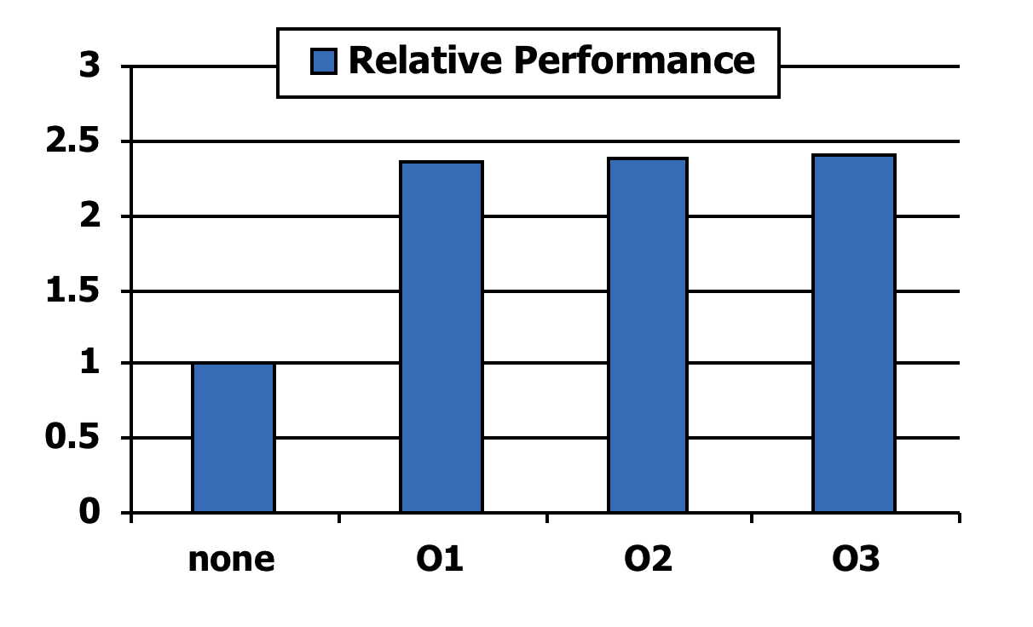
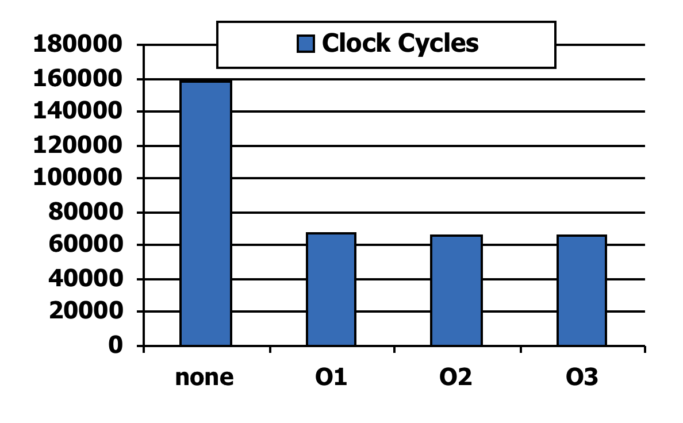
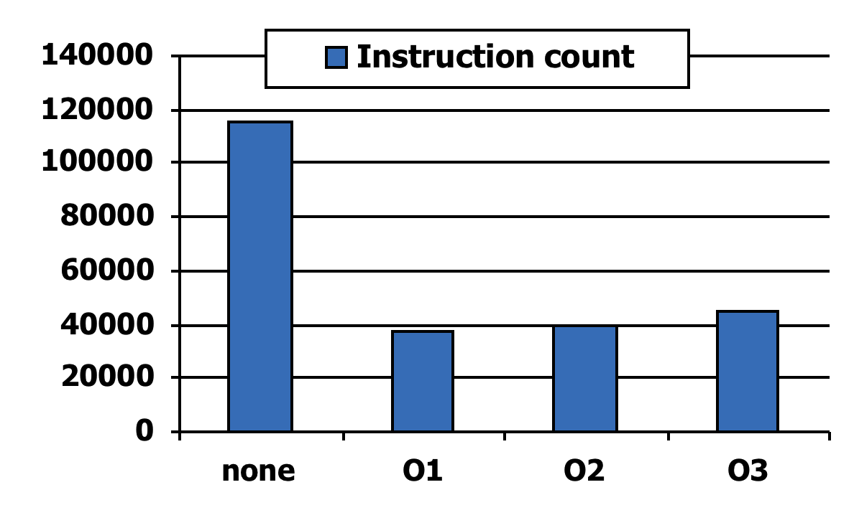
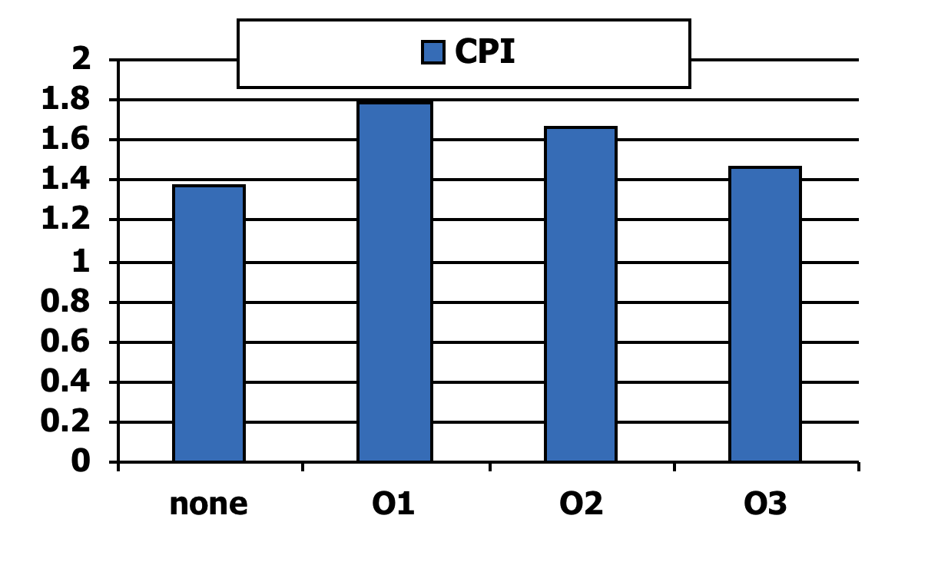
Effect of Compiler Optimization
Compiled with gcc for Pentium 4 under Linux
See section 2.15 in CD for compiler optimizations.

Slide 17
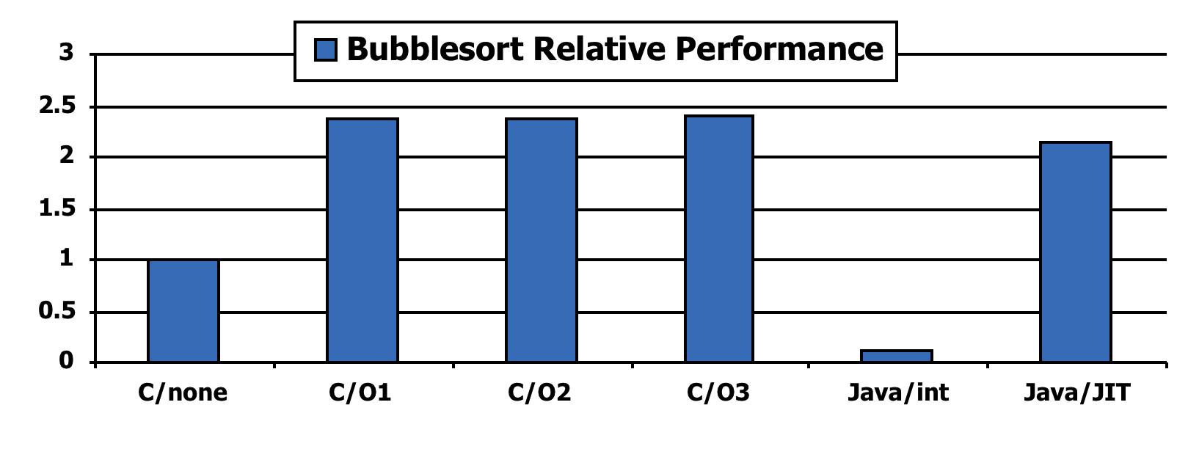
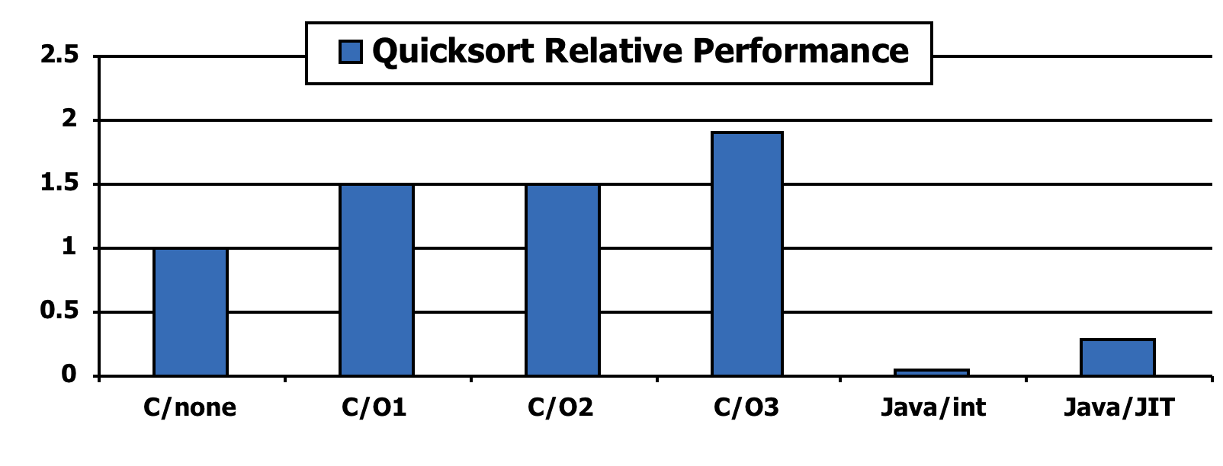
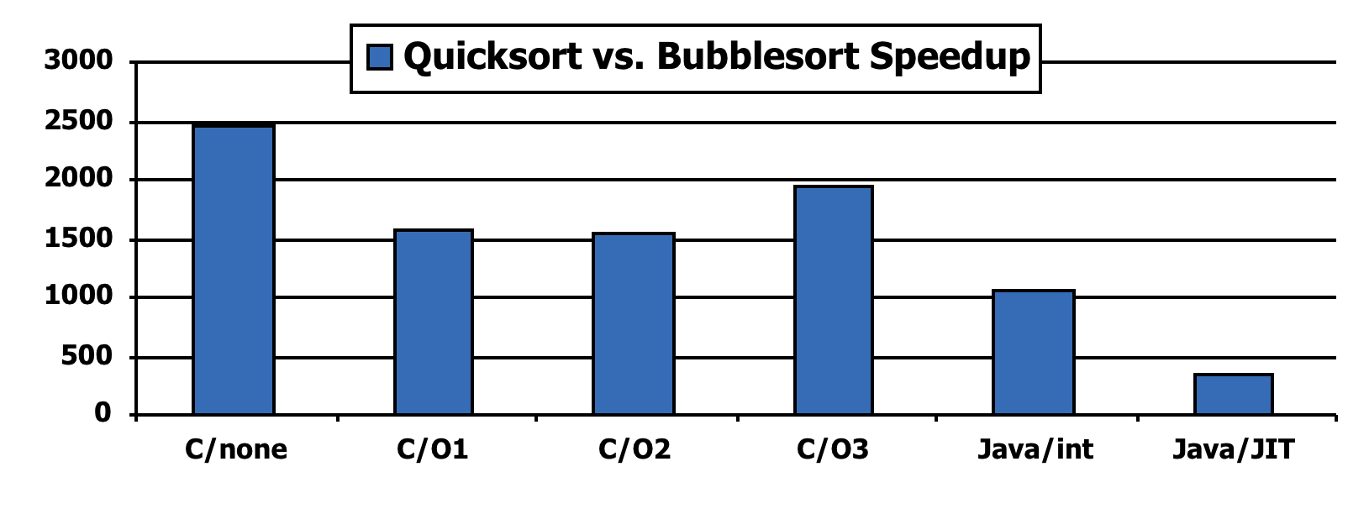
Effect of Language and Algorithm

Slide 18
Lessons Learnt
Instruction count and CPI are not good performance indicators in isolation
Compiler optimizations are sensitive to the algorithm
Java/JIT compiled code is significantly faster than JVM interpreted
Comparable to optimized C in some cases
Nothing can fix a dumb algorithm!

Slide 19
Arrays vs. Pointers
Array indexing:
Pointer indexing:
clear1(int array[], int size) { int i; for (i = 0; i < size; i += 1) array[i] = 0; } | clear2(int *array, int size) { int *p; for (p = &array[0]; p < &array[size]; p = p + 1) *p = 0; }
move $t0,$zero # i = 0 loop1: sll $t1,$t0,2 # $t1 = i * 4 add $t2,$a0,$t1 # $t2 = # &array[i] sw $zero, 0($t2) # array[i] = 0 addi $t0,$t0,1 # i = i + 1 slt $t3,$t0,$a1 # $t3 = # (i < size) bne $t3,$zero,loop1 # if (…) # goto loop1 | move $t0,$a0 # p = & array[0] sll $t1,$a1,2 # $t1 = size * 4 add $t2,$a0,$t1 # $t2 = # &array[size] loop2: sw $zero,0($t0) # Memory[p] = 0 addi $t0,$t0,4 # p = p + 4 slt $t3,$t0,$t2 # $t3 = #(p<&array[size]) bne $t3,$zero,loop2 # if (…) # goto loop2
for(…){
$t2 ← array+4×i
M[$t2] ← $zero
i = i+1
}
pointer ← v
for(…){
reg ← M[pointer]
pointer = pointer+1
}
p ← array
$t2 ← &array[size]
for(…){
M[p] ← $zero
p = p+4
}
$a0
array
$a0
array
$t0
i
P-H p. 157
$t0
p

Slide 20
Arrays vs. Pointers
Array indexing involves
Multiplying index by element size
Adding to array base address
Pointers correspond directly to memory addresses
Can avoid indexing complexity
§2.14 Arrays versus Pointers
P-H p. 157

Slide 21
Example: Clearing an Array
clear1(int array[], int size) { int i; for (i = 0; i < size; i += 1) array[i] = 0; } | clear2(int *array, int size) { int *p; for (p = &array[0]; p < &array[size]; p = p + 1) *p = 0; }
move $t0,$zero # i = 0 loop1: sll $t1,$t0,2 # $t1 = i * 4 add $t2,$a0,$t1 # $t2 = # &array[i] sw $zero, 0($t2) # array[i] = 0 addi $t0,$t0,1 # i = i + 1 slt $t3,$t0,$a1 # $t3 = # (i < size) bne $t3,$zero,loop1 # if (…) # goto loop1 | move $t0,$a0 # p = & array[0] sll $t1,$a1,2 # $t1 = size * 4 add $t2,$a0,$t1 # $t2 = # &array[size] loop2: sw $zero,0($t0) # Memory[p] = 0 addi $t0,$t0,4 # p = p + 4 slt $t3,$t0,$t2 # $t3 = #(p<&array[size]) bne $t3,$zero,loop2 # if (…) # goto loop2
add, addi, slt, sll: 1 cycle; sw: 5 cycles; bne: 2 cycles
Assume size is very large. Compute CPI. Which is faster? By how much?
P-H pp. 157-160

Slide 22
Example: Clearing an Array
clear1(int array[], int size) { int i; for (i = 0; i < size; i += 1) array[i] = 0; } | clear2(int *array, int size) { int *p; for (p = &array[0]; p < &array[size]; p = p + 1) *p = 0; }
move $t0,$zero # i = 0 1 loop1: sll $t1,$t0,2 # $t1 = i * 4 1 add $t2,$a0,$t1 # $t2 = 1 # &array[i] sw $zero, 0($t2) # array[i] = 05 addi $t0,$t0,1 # i = i + 1 1 slt $t3,$t0,$a1 # $t3 = 1 # (i < size) bne $t3,$zero,loop1 # if (…) 2 # goto loop1 | move $t0,$a0 # p = & array[0]1 sll $t1,$a1,2 # $t1 = size * 41 add $t2,$a0,$t1 # $t2 = 1 # &array[size] loop2: sw $zero,0($t0) # Memory[p] = 0 5 addi $t0,$t0,4 # p = p + 4 1 slt $t3,$t0,$t2 # $t3 = 1 #(p<&array[size]) bne $t3,$zero,loop2 # if (…) 2 # goto loop2
add, addi, slt, sll: 1 cycle; sw: 5 cycles; bne: 2 cycles
Assume size is very large. Compute CPI. Which is faster? By how much?
P-H pp. 157-160

Slide 23
Comparison of Array vs. Ptr
Array version requires shift to be inside loop
It is part of index calculation for incremented i
recalculate address in each iteration
Compiler can achieve same effect as manual use of pointers
Induction variable elimination
Better to make program clearer and safer
P-H p. 157

Slide 24
Parameter Passing
What is the difference between passing a parameter by value and passing it by reference?

Slide 25
The car.c program
#include <stdio.h>
#define STRINGLENGTH 20
typedef struct c_node{
int vehicleID;
char make[STRINGLENGTH];
char model[STRINGLENGTH];
int year;
int mileage;
double cost;
struct c_node *next;
} CarNode;
void ReadCar(CarNode *car);
void PrintCar(CarNode car);
main()
{
CarNode mycar;
ReadCar(&mycar);
PrintCar(mycar);
}
void ReadCar(CarNode *car)
{
car->vehicleID = 2;
strcpy(car->make,"DODGE");
strcpy(car->model,"STRATUS");
car->year = 1996;
car->mileage = 70000;
car->cost = 4,525.74;
}
void PrintCar(CarNode car)
{
printf("vehicleID: %d\n",car.vehicleID);
printf("make: %s\n",car.make);
printf("model: %s\n",car.model);
printf("year: %d\n",car.year);
printf("mileage: %d\n",car.mileage);
printf("cost: %f\n",car.cost);
}
Patt and Patel, pp. 419

Slide 26
The car.c program
64
next
60
cost
#define STRINGLENGTH 20
typedef struct c_node{
int vehicleID;
char make[STRINGLENGTH];
char model[STRINGLENGTH];
int year;
int mileage;
double cost;
struct c_node *next;
} CarNode;
56
52
48
mileage
44
year
40
model[20]
36
32
28
24
20
make[20]
16
12
8
4
0
vehicleID

Slide 27
The car.c program
main:
subu $sp, 168
sw $ra, 84($sp)
.frame $sp, 168, $ra
# 23 CarNode mycar;
# 25 ReadCar(&mycar);
addu $a0, $sp, 88
jal ReadCar
# 27 PrintCar(mycar);
addu $t6, $sp, 88
move $t9, $sp
addu $t0, $t6, 72
L1:
lw $t8, 0($t6)
addu $t6, $t6, 12
sw $t8, 0($t9)
lw $t7, -8($t6)
addu $t9, $t9, 12
sw $t7, -8($t9)
lw $t8, -4($t6)
sw $t8, -4($t9)
bne $t6, $t0, L1
lw $a0, 0($sp)
lw $a1, 4($sp)
lw $a2, 8($sp)
lw $a3, 12($sp)
jal PrintCar
# 28 }
move $v0, $zero
lw $ra, 84($sp)
addu $sp, 168
j $ra
#include <stdio.h>
#define STRINGLENGTH 20
typedef struct c_node{
int vehicleID;
char make[STRINGLENGTH];
char model[STRINGLENGTH];
int year;
int mileage;
double cost;
struct c_node *next;
} CarNode;
void ReadCar(CarNode *car);
void PrintCar(CarNode car);
main()
{
CarNode mycar;
ReadCar(&mycar);
PrintCar(mycar);
}

Slide 28
The car.c program
main:
subu $sp, 168
sw $ra, 84($sp)
.frame $sp, 168, $ra
# 23 CarNode mycar;
# 25 ReadCar(&mycar);
addu $a0, $sp, 88
jal ReadCar
# 27 PrintCar(mycar);
addu $t6, $sp, 88
move $t9, $sp
addu $t0, $t6, 72
L1:
lw $t8, 0($t6)
addu $t6, $t6, 12
sw $t8, 0($t9)
lw $t7, -8($t6)
addu $t9, $t9, 12
sw $t7, -8($t9)
lw $t8, -4($t6)
sw $t8, -4($t9)
bne $t6, $t0, L1
lw $a0, 0($sp)
lw $a1, 4($sp)
lw $a2, 8($sp)
lw $a3, 12($sp)
jal PrintCar
# 28 }
move $v0, $zero
lw $ra, 84($sp)
addu $sp, 168
j $ra
188
$t6
92
make[0-3]
184
88
vehicleID
180
84
176
80
172
$t8
76
$t0
168
vehicleID
72
164
$t7
68
160
64
156
60
152
next
56
148
cost
52
144
cost
48
140
44
136
mileage
40
132
year
36
128
model[16-19]
32
124
model[12-15]
28
120
model[8-11]
24
116
model[4-7]
20
112
model[0-3]
16
108
make[16-19]
12
104
make[12-15]
$t9
08
100
make[8-11]
04
96
make[4-7]
00
SP

Slide 29
The car.c program
main:
subu $sp, 168
sw $ra, 84($sp)
.frame $sp, 168, $ra
# 23 CarNode mycar;
# 25 ReadCar(&mycar);
addu $a0, $sp, 88
jal ReadCar
# 27 PrintCar(mycar);
addu $t6, $sp, 88
move $t9, $sp
addu $t0, $t6, 72
L1:
lw $t8, 0($t6)
addu $t6, $t6, 12
sw $t8, 0($t9)
lw $t7, -8($t6)
addu $t9, $t9, 12
sw $t7, -8($t9)
lw $t8, -4($t6)
sw $t8, -4($t9)
bne $t6, $t0, L1
lw $a0, 0($sp)
lw $a1, 4($sp)
lw $a2, 8($sp)
lw $a3, 12($sp)
jal PrintCar
# 28 }
move $v0, $zero
lw $ra, 84($sp)
addu $sp, 168
j $ra
188
92
make[0-3]
184
88
vehicleID
180
84
176
80
172
$t8
76
$t0
168
vehicleID
72
164
$t7
68
160
64
156
make[0-3]
60
152
next
56
148
cost
52
144
cost
48
140
44
136
mileage
40
132
year
36
128
model[16-19]
32
124
model[12-15]
28
120
model[8-11]
24
116
model[4-7]
20
112
model[0-3]
16
$t6
108
make[16-19]
12
104
make[12-15]
$t9
08
100
make[8-11]
04
96
make[4-7]
00
vehicleID
SP

Slide 30
The car.c program
main:
subu $sp, 168
sw $ra, 84($sp)
.frame $sp, 168, $ra
# 23 CarNode mycar;
# 25 ReadCar(&mycar);
addu $a0, $sp, 88
jal ReadCar
# 27 PrintCar(mycar);
addu $t6, $sp, 88
move $t9, $sp
addu $t0, $t6, 72
L1: # loop copies 3 words
lw $t8, 0($t6)
addu $t6, $t6, 12
sw $t8, 0($t9)
lw $t7, -8($t6)
addu $t9, $t9, 12
sw $t7, -8($t9)
lw $t8, -4($t6)
sw $t8, -4($t9)
bne $t6, $t0, L1
lw $a0, 0($sp)
lw $a1, 4($sp)
lw $a2, 8($sp)
lw $a3, 12($sp)
jal PrintCar
# 28 }
move $v0, $zero
lw $ra, 84($sp)
addu $sp, 168
j $ra
188
92
make[0-3]
184
88
vehicleID
180
84
176
80
172
$t8
76
168
vehicleID
72
$t0
164
make[4-7]
68
160
$t7
64
156
make[0-3]
60
152
next
56
148
cost
52
144
cost
48
140
44
136
mileage
40
132
year
36
128
model[16-19]
32
124
model[12-15]
28
120
model[8-11]
24
116
model[4-7]
$t9
20
112
model[0-3]
16
$t6
108
make[16-19]
12
104
make[12-15]
08
make[4-7]
100
make[8-11]
04
make[0-3]
96
make[4-7]
00
vehicleID
SP

Slide 31
The car.c program
main:
subu $sp, 168
sw $ra, 84($sp)
.frame $sp, 168, $ra
# 23 CarNode mycar;
# 25 ReadCar(&mycar);
addu $a0, $sp, 88
jal ReadCar
# 27 PrintCar(mycar);
addu $t6, $sp, 88
move $t9, $sp
addu $t0, $t6, 72
L1: # loop copies 3 words
lw $t8, 0($t6)
addu $t6, $t6, 12
sw $t8, 0($t9)
lw $t7, -8($t6)
addu $t9, $t9, 12
sw $t7, -8($t9)
lw $t8, -4($t6)
sw $t8, -4($t9)
bne $t6, $t0, L1
lw $a0, 0($sp)
lw $a1, 4($sp)
lw $a2, 8($sp)
lw $a3, 12($sp)
jal PrintCar
# 28 }
move $v0, $zero
lw $ra, 84($sp)
addu $sp, 168
j $ra
188
92
make[0-3]
184
88
vehicleID
180
84
176
80
172
76
168
72
164
68
160
64
next
156
60
cost2
152
next
56
cost1
148
cost2
52
144
cost1
48
mileage
140
44
year
136
mileage
$a0
40
model[16-19]
132
year
vehicleID
36
model[12-15]
128
model[16-19]
$a1
32
model[8-11]
124
model[12-15]
28
model[4-7]
120
model[8-11]
make[0-3]
24
model[0-3]
116
model[4-7]
$a2
20
make[16-19]
112
model[0-3]
16
make[12-15]
108
make[16-19]
make[4-7]
12
make[8-11]
104
make[12-15]
$a3
08
make[4-7]
100
make[8-11]
04
make[0-3]
96
make[4-7]
make[8-11]
00
vehicleID
SP

Slide 32
The car.c program
# 42 void PrintCar(CarNode car)
# 43 {
PrintCar:
subu $sp, 32
sw $ra, 28($sp)
sw $a0, 32($sp)
sw $a1, 36($sp)
sw $a2, 40($sp)
sw $a3, 44($sp)
# 44 printf("vehicleID: %d\n",car.vehicleID);
la $a0, string13
lw $a1, 32($sp)
jal printf
# 45 printf("make: %s\n",car.make);
la $a0, string14
addu $a1, $sp, 32
addu $a1, $a1, 4
jal printf
# 46 printf("model: %s\n",car.model);
la $a0, string15
addu $a1, $sp, 32
addu $a1, $a1, 24
jal printf
# 47 printf("year: %d\n",car.year);
la $a0, string16
lw $a1, 76($sp)
jal printf
188
92
make[0-3]
184
88
vehicleID
180
84
176
80
172
76
168
72
164
68
160
64
next
156
60
cost2
152
next
56
cost1
148
cost2
52
144
cost1
48
mileage
140
44
year
136
mileage
$a0
40
model[16-19]
132
year
vehicleID
36
model[12-15]
128
model[16-19]
$a1
32
model[8-11]
124
model[12-15]
28
model[4-7]
120
model[8-11]
make[0-3]
24
model[0-3]
116
model[4-7]
$a2
20
make[16-19]
112
model[0-3]
16
make[12-15]
108
make[16-19]
make[4-7]
12
make[8-11]
104
make[12-15]
$a3
08
make[4-7]
100
make[8-11]
04
make[0-3]
96
make[4-7]
make[8-11]
00
vehicleID
SP

Slide 33
Why so much copying?
The program car.c passes the datastructure CarNode
to the PrintCar function by value.
A copy of each byte of CarNode must be made in the
stack for each call of the function PrintCar.
We could, instead have passed the address of the copy
of CarNode that we already had in the stack.

Slide 34
The car2.c Program
#include <stdio.h>
#define STRINGLENGTH 20
typedef struct c_node{
int vehicleID;
char make[STRINGLENGTH];
char model[STRINGLENGTH];
int year;
int mileage;
double cost;
struct c_node *next;
} CarNode;
void ReadCar(CarNode *car);
void PrintCar(CarNode *car);
main()
{
CarNode mycar;
ReadCar(&mycar);
PrintCar(&mycar);
}
void ReadCar(CarNode ∗car)
{
car->vehicleID = 2;
strcpy(car->make,"DODGE");
strcpy(car->model,"STRATUS");
car->year = 1996;
car->mileage = 70000;
car->cost = 4,525.74;
}
void PrintCar(CarNode ∗car)
{
printf("vehicleID: %d\n",car->vehicleID);
printf("make: %s\n",car->make);
printf("model: %s\n",car->model);
printf("year: %d\n",car->year);
printf("mileage: %d\n",car->mileage);
printf("cost: %f\n",car->cost);
}

Slide 35
car-O0.s
car2-O0.s
main:
subu $sp, 112
sw $ra, 28($sp)
# 23 CarNode mycar;
# 25 ReadCar(&mycar);
addu $a0, $sp, 32
jal ReadCar
# 27 PrintCar(&mycar);
addu $a0, $sp, 32
jal PrintCar
# 28 }
move $v0, $zero
lw $ra, 28($sp)
addu $sp, 112
j $ra
#include <stdio.h>
#define STRINGLENGTH 20
typedef struct c_node{
int vehicleID;
char make[STRINGLENGTH];
char model[STRINGLENGTH];
int year;
int mileage;
double cost;
struct c_node *next;
} CarNode;
void ReadCar(CarNode *car);
void PrintCar(CarNode *car);
main()
{
CarNode mycar;
ReadCar(&mycar);
PrintCar(&mycar);
}

Slide 36
Quiz #1
predecessors and successors are two vectors of unsigned integers.
Assume that:
predecessors’ first element is stored at $fp-64
successors’ first element is stored at $fp-32
Where $fp points to the top of the stack frame of the current procedure.
Write a sequence of assembly instructions that executes the following
C statement:
successors[5] = predecessors[7];

Slide 37
Quiz #1 - Solution
predecessors and successors are two vectors of unsigned integers.
predecessors’ first element is stored at $fp-64
successors’ first element is stored at $fp-32
$t0 ← M[$fp-64+4*7]
M[$fp-32+4*5] ← $t0
----------------
$t0 ← M[$fp-36]
M[$fp-12] ← $t0
-------------
lw $t0, -36($fp)
sw $t0, -12($fp)

Slide 38
Quiz #1 - Solution
predecessors and successors are two vectors of unsigned integers.
predecessors’ first element is stored at $fp-64
successors’ first element is stored at $fp-32
$t1 ← $fp-36
$t0 ← M[$t1];
$t2 ← $fp-12
M[$t2] ← $t0;
$t1 ← $fp-36
$t0 ← M[$fp-36];
$t2 ← $fp-12
M[$fp-12] ← $t0;
successors[5] = predecessors[7];
$t0 ← predecessors[7];
successors[5] ← $t0;
$t1 ← Addr(predecessor[7]);
$t0 ← M[$t1];
$t2 ← Addr(successors[5]);
M[$t2] ← $t0;
$t0 ← M[$fp-36];
M[$fp-12] ← $t0;
lw $t0, -36($fp)
sw $t0, -12($fp)
$t1 ← $fp-64+7*4
$t0 ← M[$t1];
$t2 ← $fp-32+5*4
M[$t2] ← $t0;

Slide 39
Quiz #2
names is an array of pointers to strings.
Each position of names contains a pointer to a
null-terminated string.
Assume that the first element of names is stored in
the memory position $sp+16.
Write a sequence of MIPS assembly instructions
that counts the number of characters in the string
whose pointer is at names[7].

Slide 40
Quiz #2
names is an array of pointers to strings.
Each position of names contains a pointer to a null terminated string.
Assume that the first element of names is stored in the memory position $fp-48.
Write a sequence of MIPS assembly instructions that counts the
number of characters in the string whose pointer is at names[7].
count = 0;
c = names[7];
while (*c != 0)
{
count = count+1;
c = c+1;
}
$t0 ← 0;
$t2 ← names[7];
while ( M[$t2] != 0)
{
$t0 = $t0+1;
$t2 = $t2+1;
}
$t0 ← 0;
$t1 ← Address(names[7]);
$t2 ← M[$t1];
while (M[$t2] != 0)
{
$t0 = $t0+1;
$t2 = $t2+1;
}
$t0 ← 0;
$t1 ← $fp-48+7*4
$t2 ← M[$t1];
while (M[$t2] != 0)
{
$t0 = $t0+1;
$t2 = $t2+1;
}

Slide 41
Quiz #2
names is an array of pointers to strings.
Each position of names contains a pointer to a null terminated string.
Assume that the first element of names is stored in the memory position $fp-48.
Write a sequence of MIPS assembly instructions that counts the
number of characters in the string whose pointer is at names[7].
$t0 ← 0;
$t1 ← $fp-48+7*4
$t2 ← M[$t1];
while (M[$t2] != 0)
{
$t0 = $t0+1;
$t2 = $t2+1;
}
$t0 ← 0;
$t2 ← M[$fp-20];
while (M[$t2] != 0)
{
$t0 = $t0+1;
$t2 = $t2+1;
}
add $t0, $zero, $zero
lw $t2, -20($fp)
lb $t3,0($t2)
beq $t3, $zero, done
addi $t0, $t0, 1
addi $t2, $t2, 1
j loop;
done:
loop:

Slide 42
Quiz #2 – Alternative Solution
names is an array of pointers to strings.
Each position of names contains a pointer to a null terminated string.
Assume that the first element of names is stored in the memory position $fp-48.
Write a sequence of MIPS assembly instructions that counts the
number of characters in the string whose pointer is at names[7].
Previous Solution:
Alternative Solution:
count = 0;
c = names[7];
while (*c != 0)
{
count = count+1;
c = c+1;
}
count = 0;
c = names[7];
count = c;
while (*c != 0)
{
c = c+1;
}
count = c-count;

Slide 43
The meaning of *p
1 void foo(int *p, int x)
2 {
…
25 *p = x;
…
x = *p;
}
What is the meaning of the statement in line 25
of this C program?
What does p contain?
A memory address
What does x contain?
An integer value
What action the program should do to execute
line 25?
Store the value of x in the memory
location whose address is in p.
p
0x10001008
0x10001018
0x10001014
x
42
0x10001010
0x1000100C
0x10001008
42
What MIPS assembly instruction(s)
are needed to execute line 25?
0x10001004
0x10001000
sw $a1, 0($a0) # 0($a0) ← $a1

Slide 44
The meaning of *p
1 void foo(int *p, int x)
2 {
…
25 *p = x;
…
x = *p;
}
What action the program should do to execute
line 30?
Load the value from the memory
location whose address is in p.
What MIPS assembly instruction(s)
are needed to execute line 30?
lw $a1, 0($a0) # $a1 ← 0($a0)
p
0x10001008
0x10001018
0x10001014
x
42
0x10001010
74
0x1000100C
0x10001008
74
0x10001004
0x10001000

Slide 45
The meaning of *p
Now p and x are in memory in the local stack
frame. Assume that:
p ↔ $fp-4
x ↔ $fp-12
1 void foo(…)
2 {
3 int *p;
4 int x;
….
25 *p = x;
…
x = *p;
}
Now, what actions are needed to execute line 25?
1. Load the address in p into a register (say $s0).
2. Load the value of x into a register (say $s1).
3. Store the value in $s1 into the address in $s0.
0x10001018
0x10001014
0x10001010
$sp
$s0
0x1000100C
0x1000004
0x10001008
0x10001008
42
0x10001004
$fp
$s1
0x10001000
0x10000010
42
…
What MIPS assembly instruction(s)
are needed to execute line 25?
0x10000018
0x10000014
fp
0x10000010
p
lw $s0, -4($fp) # $s0 ← p
lw $s1, -12($fp) # $s1 ← x
sw $s1, 0($s0) # *p ← x
0x1000000C
0x10001008
0x10000008
x
sp
0x10000004
42
0x10000000

Slide 46
The meaning of *p
What is the difference
between the address “in p”
and the address “of p”?
Now p and x are in memory in the local stack
frame. Assume that:
p ↔ $fp-4
x ↔ $fp-12
1 void foo(…)
2 {
3 int *p;
4 int x;
…
25 *p = x;
…
x = *p;
}
Now, what actions are needed to execute line 30?
1. Load the address in p into a register (say $s0).
2. Load the value of the memory whose address is in $s0
into a register (say $t1).
3. Store the value in $t1 into the address of x.
0x10001018
0x10001014
0x10001010
$sp
$s0
0x1000100C
0x1000004
0x10001008
0x10001008
74
0x10001004
$fp
$s1
0x10001000
0x10000010
42
…
What MIPS assembly instruction(s)
are needed to execute line 30?
$t1
74
0x10000018
0x10000014
fp
0x10000010
p
lw $s0, -4($fp) # $s0 ← p
lw $t1, 0($s0) # $s1 ← x
sw $t1, -12($fp) # x ← *p
0x1000000C
0x10001008
0x10000008
x
sp
0x10000004
42
74
0x10000000

Slide 47
Quiz #3
Consider the following C function:
int ReadGraph(FILE *input_file, unsigned int **successors, char ***names)
{
unsigned int temp = 0;
unsigned int node = 0;
/* Input code that uses input_file removed for clarity */
(*successors)[node] = temp;
printf(“name = %d\n”,*names[node]);
}
Write the MIPS assembly code for the statement immediately before the call to printf.
Assume:
temp ⟷ $s0
node ⟷ $s1

Slide 48
Quiz #3 - Solution
0($a1) represents a load from the address
in $a1 with offset 0.
temp ← $s0
node ← $s1
$t0 contains the base address of
an array of pointers.
(*successors)[node] ← temp;
$t0 ← 0($a1)
$t2 ← 4*node
$t1 ← $t0 + $t2
0($t1) ← temp;
$t0 ← 0($a1)
$t1 ← $t0 + 4*node
0($t1) ← temp;
0($a1)[node] ← temp;
$t0 ← 0($a1)
$t0[node] ← temp;
lw $t0, 0($a1)
sll $t2, $s1, 2
add $t1, $t0, $t2
sw $s0, 0($t1)
$t0 ← 0($a1)
$t1 ← Address($t0[node])
0($t1) ← temp;
int ReadGraph(FILE *input_file, unisgned int **successors, char ***names)
{
unsigned int temp = 0;
unsigned int node;
(*successors)[node] = temp;
printf(“name = %d\n”,*names[node]);
}
Here 0($t1) is a
store into the
address in $t1 with
offset of zero

Slide 49
Quiz #4
Consider the following C function:
int ReadGraph(FILE *input_file, unsigned int **successors, char ***names)
{
unsigned int temp;
unsigned int node;
(*successors)[node] = temp;
printf(“name = %s\n”,(*names)[node]);
}
Write the MIPS assembly code to initialize the value of $a1 in
the function call to printf.
Assume:
node ⟷ $s1
names ⟷ $a2

Slide 50
How did we ended up with ***names ?
A
d
a
m
\0
C
e
c
i
l
y
\0
M
u
r
r
a
y
\0
J
a
m
e
s
\0

Slide 51
How did we ended up with ***names ?
***names ≡ **names[0]
names
A
d
a
m
\0
*names
*(**names+1) ≡ **names[1]
**names
C
e
c
i
l
y
\0
*(**names+2) ≡ **names[2]
M
u
r
r
a
y
\0
*(**names+3) ≡ **names[3]
J
a
m
e
s
\0

Slide 52
int ReadGraph(FILE *input_file, unisgned int **successors, char ***names)
{
…
printf(“..”,(*names)[node]);
}
lw $t0, 0($a2) # $t0 ← *names
sll $t2, $s1, 2 # $t2 ← 4×node
add $t3, $t0, $t2 # $t3 ← (*names) + 4×node
lw $t0, 0($a2) # $t0 ← *names
$a2
A
d
a
m
\0
node ⟷ $s1
names ⟷ $a2
C
e
c
i
l
y
\0
$t0
M
u
r
r
a
y
\0
$t3
Animation assumes that node = 2.
J
a
m
e
s
\0

Slide 53
int ReadGraph(FILE *input_file, unsigned int **successors, char ***names)
{
…
printf(“..”,(*names)[node]);
}
lw $t0, 0($a2) # $t0 ← *names
sll $t2, $s1, 2 # $t2 ← 4×node
add $t3, $t0, $t2 # $t3 ← (*names) + 4×node
lw $a1, 0(t3) # $a1 ← (*names)[node]
$a2
A
d
a
m
\0
node ↔ $s1
names ↔ $a2
C
e
c
i
l
y
\0
$t0
M
u
r
r
a
y
\0
$t3
$a1
Animation assumes that node = 2.
J
a
m
e
s
\0

Slide 54
int ReadGraph(FILE *input_file, unsigned int **successors, char ***names)
{
unsigned int temp;
unsigned int node;
(*successors)[node] = temp;
printf(“name = %s\n”,(*names)[node]);
}
lw $t0, 0($a2) # $t0 ← *names
sll $t2, $s1, 2 # $t2 ← 4×node
add $t3, $t1, $t2 # $t3 ← (*names) + 4×node
lw $a1, 0(t3) # $a1 ← (*names)[node]

Slide 55
Quiz #7
Stack
⟨apple⟩
8
Next we will
simulate each
line of the C code.
⟨ptr⟩
4
$sp
⟨ind⟩
0
Write MIPS assembly for the
following program.
Assume that:
apple ↔ $sp+8
ptr ↔ $sp+4
ind ↔ $sp+0
# 7 ind = &ptr;
addi $t0, $sp, 4 # $t0 ← &ptr
sw $t0, 0($sp) # ind ← &ptr
# 8 *ind = &apple;
lw $t0, 0($sp) # $t0 ← ind
addi $t1, $sp,8 # $t1 ← &apple
sw $t1, 0($t0) # *ind ← &apple
# 9 **ind = 123;
addi $t3,$zero,123
lw $t4, 0($sp) # $t4 ← ind
lw $t5, 0($t4) # $t5 ← *ind
sw $t3, 0($t5) # **ind ← 123
# 10 ind++;
lw $t0, 0($sp) # $t0 ← ind
addi $t0, $t0, 4 # $t0 ← ind + 4
sw $t0, 0($sp) # ind ← ind + 4
# 11 *ptr++;
lw $t6, 4($sp) # $t6 ← ptr
lw $t7, 0($t6) # $t7 ← *ptr
addi $t7, $t7, 1 # $t7 ← (*ptr) + 1
sw $t7, 0($t6) # *ptr ← (*ptr) + 1
# 12 apple++;
lw $t8, 8(sp) # $t8 ← apple
addi $t8, $t8, 1 # $t8 ← apple + 1
sw $t8, 8(sp) # apple ← apple + 1
1 #include <stdio.h>
2 main()
3 {
4 int apple;
5 int *ptr;
6 int **ind;
7 ind = &ptr;
8 *ind = &apple;
9 **ind = 123;
10 ind++;
11 *ptr++;
12 apple++;
13 printf(“%x %x %d\n”, ind, ptr, apple);
14 }

Slide 56
Quiz #7
Stack
⟨apple⟩
8
⟨ptr⟩
4
$sp
$sp+4
0
Write MIPS assembly for the
following program.
Assume that:
apple ↔ $sp+8
ptr ↔ $sp+4
ind ↔ $sp+0
# 7 ind = &ptr;
addi $t0, $sp, 4 # $t0 ← &ptr
sw $t0, 0($sp) # ind ← &ptr
# 8 *ind = &apple;
lw $t0, 0($sp) # $t0 ← ind
addi $t1, $sp,8 # $t1 ← &apple
sw $t1, 0($t0) # *ind ← &apple
# 9 **ind = 123;
addi $t3,$zero,123
lw $t4, 0($sp) # $t4 ← ind
lw $t5, 0($t4) # $t5 ← *ind
sw $t3, 0($t5) # **ind ← 123
# 10 ind++;
lw $t0, 0($sp) # $t0 ← ind
addi $t0, $t0, 4 # $t0 ← ind + 4
sw $t0, 0($sp) # ind ← ind + 4
# 11 *ptr++;
lw $t6, 4($sp) # $t6 ← ptr
lw $t7, 0($t6) # $t7 ← *ptr
addi $t7, $t7, 1 # $t7 ← (*ptr) + 1
sw $t7, 0($t6) # *ptr ← (*ptr) + 1
# 12 apple++;
lw $t8, 8(sp) # $t8 ← apple
addi $t8, $t8, 1 # $t8 ← apple + 1
sw $t8, 8(sp) # apple ← apple + 1
1 #include <stdio.h>
2 main()
3 {
4 int apple;
5 int *ptr;
6 int **ind;
7 ind = &ptr;
8 *ind = &apple;
9 **ind = 123;
10 ind++;
11 *ptr++;
12 apple++;
13 printf(“%x %x %d\n”, ind, ptr, apple);
14 }

Slide 57
Quiz #7
Stack
⟨apple⟩
8
⟨ptr⟩
4
$sp
$sp+4
0
Write MIPS assembly for the
following program.
Assume that:
apple ↔ $sp+8
ptr ↔ $sp+4
ind ↔ $sp+0
# 7 ind = &ptr;
addi $t0, $sp, 4 # $t0 ← &ptr
sw $t0, 0($sp) # ind ← &ptr
# 8 *ind = &apple;
lw $t0, 0($sp) # $t0 ← ind
addi $t1, $sp,8 # $t1 ← &apple
sw $t1, 0($t0) # *ind ← &apple
# 9 **ind = 123;
addi $t3,$zero,123
lw $t4, 0($sp) # $t4 ← ind
lw $t5, 0($t4) # $t5 ← *ind
sw $t3, 0($t5) # **ind ← 123
# 10 ind++;
lw $t0, 0($sp) # $t0 ← ind
addi $t0, $t0, 4 # $t0 ← ind + 4
sw $t0, 0($sp) # ind ← ind + 4
# 11 *ptr++;
lw $t6, 4($sp) # $t6 ← ptr
lw $t7, 0($t6) # $t7 ← *ptr
addi $t7, $t7, 1 # $t7 ← (*ptr) + 1
sw $t7, 0($t6) # *ptr ← (*ptr) + 1
# 12 apple++;
lw $t8, 8(sp) # $t8 ← apple
addi $t8, $t8, 1 # $t8 ← apple + 1
sw $t8, 8(sp) # apple ← apple + 1
1 #include <stdio.h>
2 main()
3 {
4 int apple;
5 int *ptr;
6 int **ind;
7 ind = &ptr;
8 *ind = &apple;
9 **ind = 123;
10 ind++;
11 *ptr++;
12 apple++;
13 printf(“%x %x %d\n”, ind, ptr, apple);
14 }

Slide 58
Quiz #7
Stack
⟨apple⟩
8
$sp+8
4
$sp
$sp+4
0
Write MIPS assembly for the
following program.
Assume that:
apple ↔ $sp+8
ptr ↔ $sp+4
ind ↔ $sp+0
# 7 ind = &ptr;
addi $t0, $sp, 4 # $t0 ← &ptr
sw $t0, 0($sp) # ind ← &ptr
# 8 *ind = &apple;
lw $t0, 0($sp) # $t0 ← ind
addi $t1, $sp,8 # $t1 ← &apple
sw $t1, 0($t0) # *ind ← &apple
# 9 **ind = 123;
addi $t3,$zero,123
lw $t4, 0($sp) # $t4 ← ind
lw $t5, 0($t4) # $t5 ← *ind
sw $t3, 0($t5) # **ind ← 123
# 10 ind++;
lw $t0, 0($sp) # $t0 ← ind
addi $t0, $t0, 4 # $t0 ← ind + 4
sw $t0, 0($sp) # ind ← ind + 4
# 11 *ptr++;
lw $t6, 4($sp) # $t6 ← ptr
lw $t7, 0($t6) # $t7 ← *ptr
addi $t7, $t7, 1 # $t7 ← (*ptr) + 1
sw $t7, 0($t6) # *ptr ← (*ptr) + 1
# 12 apple++;
lw $t8, 8(sp) # $t8 ← apple
addi $t8, $t8, 1 # $t8 ← apple + 1
sw $t8, 8(sp) # apple ← apple + 1
1 #include <stdio.h>
2 main()
3 {
4 int apple;
5 int *ptr;
6 int **ind;
7 ind = &ptr;
8 *ind = &apple;
9 **ind = 123;
10 ind++;
11 *ptr++;
12 apple++;
13 printf(“%x %x %d\n”, ind, ptr, apple);
14 }

Slide 59
Quiz #7
Stack
⟨apple⟩
8
$sp+8
4
$sp
$sp+4
0
Write MIPS assembly for the
following program.
Assume that:
apple ↔ $sp+8
ptr ↔ $sp+4
ind ↔ $sp+0
# 7 ind = &ptr;
addi $t0, $sp, 4 # $t0 ← &ptr
sw $t0, 0($sp) # ind ← &ptr
# 8 *ind = &apple;
lw $t0, 0($sp) # $t0 ← ind
addi $t1, $sp,8 # $t1 ← &apple
sw $t1, 0($t0) # *ind ← &apple
# 9 **ind = 123;
addi $t3,$zero,123
lw $t4, 0($sp) # $t4 ← ind
lw $t5, 0($t4) # $t5 ← *ind
sw $t3, 0($t5) # **ind ← 123
# 10 ind++;
lw $t0, 0($sp) # $t0 ← ind
addi $t0, $t0, 4 # $t0 ← ind + 4
sw $t0, 0($sp) # ind ← ind + 4
# 11 *ptr++;
lw $t6, 4($sp) # $t6 ← ptr
lw $t7, 0($t6) # $t7 ← *ptr
addi $t7, $t7, 1 # $t7 ← (*ptr) + 1
sw $t7, 0($t6) # *ptr ← (*ptr) + 1
# 12 apple++;
lw $t8, 8(sp) # $t8 ← apple
addi $t8, $t8, 1 # $t8 ← apple + 1
sw $t8, 8(sp) # apple ← apple + 1
1 #include <stdio.h>
2 main()
3 {
4 int apple;
5 int *ptr;
6 int **ind;
7 ind = &ptr;
8 *ind = &apple;
9 **ind = 123;
10 ind++;
11 *ptr++;
12 apple++;
13 printf(“%x %x %d\n”, ind, ptr, apple);
14 }

Slide 60
Quiz #7
Stack
123
8
$sp+8
4
$sp
$sp+4
0
Write MIPS assembly for the
following program.
Assume that:
apple ↔ $sp+8
ptr ↔ $sp+4
ind ↔ $sp+0
# 7 ind = &ptr;
addi $t0, $sp, 4 # $t0 ← &ptr
sw $t0, 0($sp) # ind ← &ptr
# 8 *ind = &apple;
lw $t0, 0($sp) # $t0 ← ind
addi $t1, $sp,8 # $t1 ← &apple
sw $t1, 0($t0) # *ind ← &apple
# 9 **ind = 123;
addi $t3,$zero,123
lw $t4, 0($sp) # $t4 ← ind
lw $t5, 0($t4) # $t5 ← *ind
sw $t3, 0($t5) # **ind ← 123
# 10 ind++;
lw $t0, 0($sp) # $t0 ← ind
addi $t0, $t0, 4 # $t0 ← ind + 4
sw $t0, 0($sp) # ind ← ind + 4
# 11 *ptr++;
lw $t6, 4($sp) # $t6 ← ptr
lw $t7, 0($t6) # $t7 ← *ptr
addi $t7, $t7, 1 # $t7 ← (*ptr) + 1
sw $t7, 0($t6) # *ptr ← (*ptr) + 1
# 12 apple++;
lw $t8, 8(sp) # $t8 ← apple
addi $t8, $t8, 1 # $t8 ← apple + 1
sw $t8, 8(sp) # apple ← apple + 1
1 #include <stdio.h>
2 main()
3 {
4 int apple;
5 int *ptr;
6 int **ind;
7 ind = &ptr;
8 *ind = &apple;
9 **ind = 123;
10 ind++;
11 *ptr++;
12 apple++;
13 printf(“%x %x %d\n”, ind, ptr, apple);
14 }

Slide 61
Quiz #7
Stack
123
8
$sp+8
4
$sp
$sp+4
0
Write MIPS assembly for the
following program.
Assume that:
apple ↔ $sp+8
ptr ↔ $sp+4
ind ↔ $sp+0
# 7 ind = &ptr;
addi $t0, $sp, 4 # $t0 ← &ptr
sw $t0, 0($sp) # ind ← &ptr
# 8 *ind = &apple;
lw $t0, 0($sp) # $t0 ← ind
addi $t1, $sp,8 # $t1 ← &apple
sw $t1, 0($t0) # *ind ← &apple
# 9 **ind = 123;
addi $t3,$zero,123
lw $t4, 0($sp) # $t4 ← ind
lw $t5, 0($t4) # $t5 ← *ind
sw $t3, 0($t5) # **ind ← 123
# 10 ind++;
lw $t0, 0($sp) # $t0 ← ind
addi $t0, $t0, 4 # $t0 ← ind + 4
sw $t0, 0($sp) # ind ← ind + 4
# 11 *ptr++;
lw $t6, 4($sp) # $t6 ← ptr
lw $t7, 0($t6) # $t7 ← *ptr
addi $t7, $t7, 1 # $t7 ← (*ptr) + 1
sw $t7, 0($t6) # *ptr ← (*ptr) + 1
# 12 apple++;
lw $t8, 8(sp) # $t8 ← apple
addi $t8, $t8, 1 # $t8 ← apple + 1
sw $t8, 8(sp) # apple ← apple + 1
1 #include <stdio.h>
2 main()
3 {
4 int apple;
5 int *ptr;
6 int **ind;
7 ind = &ptr;
8 *ind = &apple;
9 **ind = 123;
10 ind++;
11 *ptr++;
12 apple++;
13 printf(“%x %x %d\n”, ind, ptr, apple);
14 }

Slide 62
Quiz #7
Stack
123
8
$sp+8
4
$sp
$sp+8
0
Write MIPS assembly for the
following program.
Assume that:
apple ↔ $sp+8
ptr ↔ $sp+4
ind ↔ $sp+0
# 7 ind = &ptr;
addi $t0, $sp, 4 # $t0 ← &ptr
sw $t0, 0($sp) # ind ← &ptr
# 8 *ind = &apple;
lw $t0, 0($sp) # $t0 ← ind
addi $t1, $sp,8 # $t1 ← &apple
sw $t1, 0($t0) # *ind ← &apple
# 9 **ind = 123;
addi $t3,$zero,123
lw $t4, 0($sp) # $t4 ← ind
lw $t5, 0($t4) # $t5 ← *ind
sw $t3, 0($t5) # **ind ← 123
# 10 ind++;
lw $t0, 0($sp) # $t0 ← ind
addi $t0, $t0, 4 # $t0 ← ind + 4
sw $t0, 0($sp) # ind ← ind + 4
# 11 *ptr++;
lw $t6, 4($sp) # $t6 ← ptr
lw $t7, 0($t6) # $t7 ← *ptr
addi $t7, $t7, 1 # $t7 ← (*ptr) + 1
sw $t7, 0($t6) # *ptr ← (*ptr) + 1
# 12 apple++;
lw $t8, 8(sp) # $t8 ← apple
addi $t8, $t8, 1 # $t8 ← apple + 1
sw $t8, 8(sp) # apple ← apple + 1
1 #include <stdio.h>
2 main()
3 {
4 int apple;
5 int *ptr;
6 int **ind;
7 ind = &ptr;
8 *ind = &apple;
9 **ind = 123;
10 ind++;
11 *ptr++;
12 apple++;
13 printf(“%x %x %d\n”, ind, ptr, apple);
14 }

Slide 63
Quiz #7
Stack
123
8
$sp+8
4
$sp
$sp+8
0
Write MIPS assembly for the
following program.
Assume that:
apple ↔ $sp+8
ptr ↔ $sp+4
ind ↔ $sp+0
# 7 ind = &ptr;
addi $t0, $sp, 4 # $t0 ← &ptr
sw $t0, 0($sp) # ind ← &ptr
# 8 *ind = &apple;
lw $t0, 0($sp) # $t0 ← ind
addi $t1, $sp,8 # $t1 ← &apple
sw $t1, 0($t0) # *ind ← &apple
# 9 **ind = 123;
addi $t3,$zero,123
lw $t4, 0($sp) # $t4 ← ind
lw $t5, 0($t4) # $t5 ← *ind
sw $t3, 0($t5) # **ind ← 123
# 10 ind++;
lw $t0, 0($sp) # $t0 ← ind
addi $t0, $t0, 4 # $t0 ← ind + 4
sw $t0, 0($sp) # ind ← ind + 4
# 11 *ptr++;
lw $t6, 4($sp) # $t6 ← ptr
lw $t7, 0($t6) # $t7 ← *ptr
addi $t7, $t7, 1 # $t7 ← (*ptr) + 1
sw $t7, 0($t6) # *ptr ← (*ptr) + 1
# 12 apple++;
lw $t8, 8(sp) # $t8 ← apple
addi $t8, $t8, 1 # $t8 ← apple + 1
sw $t8, 8(sp) # apple ← apple + 1
1 #include <stdio.h>
2 main()
3 {
4 int apple;
5 int *ptr;
6 int **ind;
7 ind = &ptr;
8 *ind = &apple;
9 **ind = 123;
10 ind++;
11 *ptr++;
12 apple++;
13 printf(“%x %x %d\n”, ind, ptr, apple);
14 }

Slide 64
Quiz #7
Stack
124
8
$sp+8
4
$sp
$sp+8
0
Write MIPS assembly for the
following program.
Assume that:
apple ↔ $sp+8
ptr ↔ $sp+4
ind ↔ $sp+0
# 7 ind = &ptr;
addi $t0, $sp, 4 # $t0 ← &ptr
sw $t0, 0($sp) # ind ← &ptr
# 8 *ind = &apple;
lw $t0, 0($sp) # $t0 ← ind
addi $t1, $sp,8 # $t1 ← &apple
sw $t1, 0($t0) # *ind ← &apple
# 9 **ind = 123;
addi $t3,$zero,123
lw $t4, 0($sp) # $t4 ← ind
lw $t5, 0($t4) # $t5 ← *ind
sw $t3, 0($t5) # **ind ← 123
# 10 ind++;
lw $t0, 0($sp) # $t0 ← ind
addi $t0, $t0, 4 # $t0 ← ind + 4
sw $t0, 0($sp) # ind ← ind + 4
# 11 *ptr++;
lw $t6, 4($sp) # $t6 ← ptr
lw $t7, 0($t6) # $t7 ← *ptr
addi $t7, $t7, 1 # $t7 ← (*ptr) + 1
sw $t7, 0($t6) # *ptr ← (*ptr) + 1
# 12 apple++;
lw $t8, 8(sp) # $t8 ← apple
addi $t8, $t8, 1 # $t8 ← apple + 1
sw $t8, 8(sp) # apple ← apple + 1
1 #include <stdio.h>
2 main()
3 {
4 int apple;
5 int *ptr;
6 int **ind;
7 ind = &ptr;
8 *ind = &apple;
9 **ind = 123;
10 ind++;
11 *ptr++;
12 apple++;
13 printf(“%x %x %d\n”, ind, ptr, apple);
14 }

Slide 65
Quiz #7
Stack
124
8
$sp+8
4
$sp
$sp+8
0
Write MIPS assembly for the
following program.
Assume that:
apple ↔ $sp+8
ptr ↔ $sp+4
ind ↔ $sp+0
# 7 ind = &ptr;
addi $t0, $sp, 4 # $t0 ← &ptr
sw $t0, 0($sp) # ind ← &ptr
# 8 *ind = &apple;
lw $t0, 0($sp) # $t0 ← ind
addi $t1, $sp,8 # $t1 ← &apple
sw $t1, 0($t0) # *ind ← &apple
# 9 **ind = 123;
addi $t3,$zero,123
lw $t4, 0($sp) # $t4 ← ind
lw $t5, 0($t4) # $t5 ← *ind
sw $t3, 0($t5) # **ind ← 123
# 10 ind++;
lw $t0, 0($sp) # $t0 ← ind
addi $t0, $t0, 4 # $t0 ← ind + 4
sw $t0, 0($sp) # ind ← ind + 4
# 11 *ptr++;
lw $t6, 4($sp) # $t6 ← ptr
lw $t7, 0($t6) # $t7 ← *ptr
addi $t7, $t7, 1 # $t7 ← (*ptr) + 1
sw $t7, 0($t6) # *ptr ← (*ptr) + 1
# 12 apple++;
lw $t8, 8(sp) # $t8 ← apple
addi $t8, $t8, 1 # $t8 ← apple + 1
sw $t8, 8(sp) # apple ← apple + 1
1 #include <stdio.h>
2 main()
3 {
4 int apple;
5 int *ptr;
6 int **ind;
7 ind = &ptr;
8 *ind = &apple;
9 **ind = 123;
10 ind++;
11 *ptr++;
12 apple++;
13 printf(“%x %x %d\n”, ind, ptr, apple);
14 }

Slide 66
Quiz #7
Stack
125
8
$sp+8
4
$sp
$sp+8
0
Write MIPS assembly for the
following program.
Assume that:
apple ↔ $sp+8
ptr ↔ $sp+4
ind ↔ $sp+0
# 7 ind = &ptr;
addi $t0, $sp, 4 # $t0 ← &ptr
sw $t0, 0($sp) # ind ← &ptr
# 8 *ind = &apple;
lw $t0, 0($sp) # $t0 ← ind
addi $t1, $sp,8 # $t1 ← &apple
sw $t1, 0($t0) # *ind ← &apple
# 9 **ind = 123;
addi $t3,$zero,123
lw $t4, 0($sp) # $t4 ← ind
lw $t5, 0($t4) # $t5 ← *ind
sw $t3, 0($t5) # **ind ← 123
# 10 ind++;
lw $t0, 0($sp) # $t0 ← ind
addi $t0, $t0, 4 # $t0 ← ind + 4
sw $t0, 0($sp) # ind ← ind + 4
# 11 *ptr++;
lw $t6, 4($sp) # $t6 ← ptr
lw $t7, 0($t6) # $t7 ← *ptr
addi $t7, $t7, 1 # $t7 ← (*ptr) + 1
sw $t7, 0($t6) # *ptr ← (*ptr) + 1
# 12 apple++;
lw $t8, 8(sp) # $t8 ← apple
addi $t8, $t8, 1 # $t8 ← apple + 1
sw $t8, 8(sp) # apple ← apple + 1
1 #include <stdio.h>
2 main()
3 {
4 int apple;
5 int *ptr;
6 int **ind;
7 ind = &ptr;
8 *ind = &apple;
9 **ind = 123;
10 ind++;
11 *ptr++;
12 apple++;
13 printf(“%x %x %d\n”, ind, ptr, apple);
14 }

